Slide 1
Obstacle Avoidance for a Car-like Robot using the Dynamic Window Approach
Field and Service Robotics – Final Project
a.y. 2024-25
Luciana Ercolanese – P38000197

Slide 2
Table of contents
System Architecture
Model of the Car-Like Robot
The Dynamic Window Approach
Simulations
Conclusions and Future Work

Slide 3
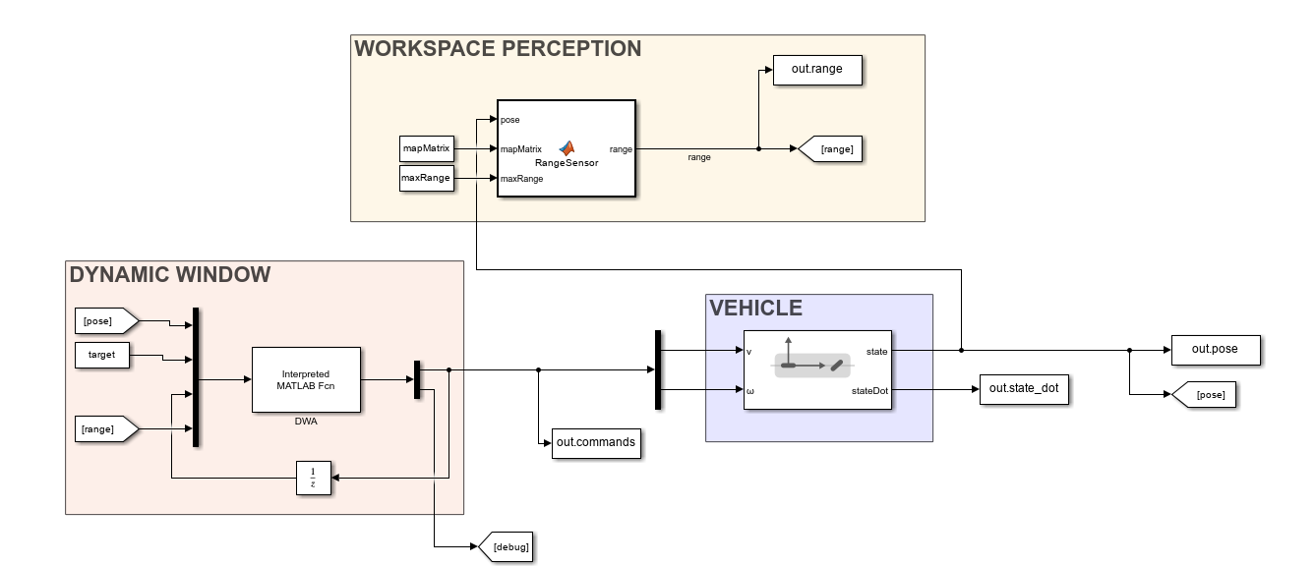
System Architecture

Slide 4
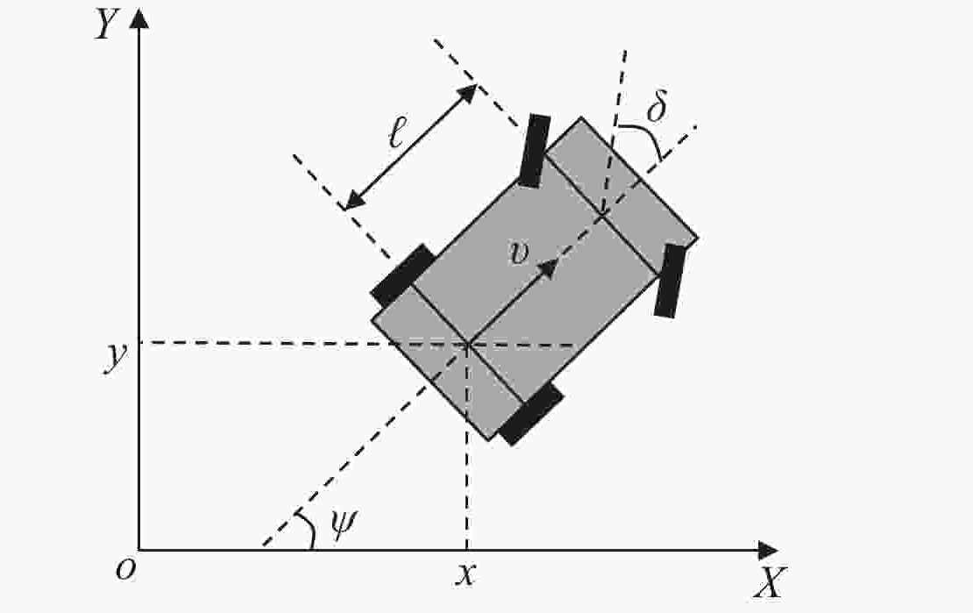
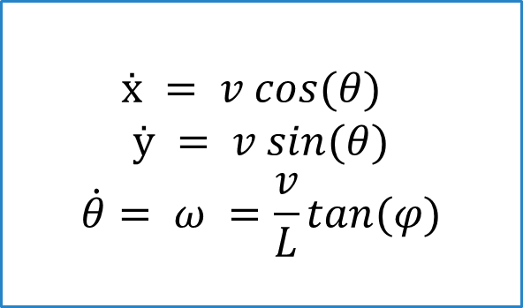
Model of the Car-like Robot
$$ẋ = v cos(θ)$$
$$ẏ = v sin(θ)$$
$$\dot{θ}= ω =\frac{v}{L}tan(φ)$$

Slide 5
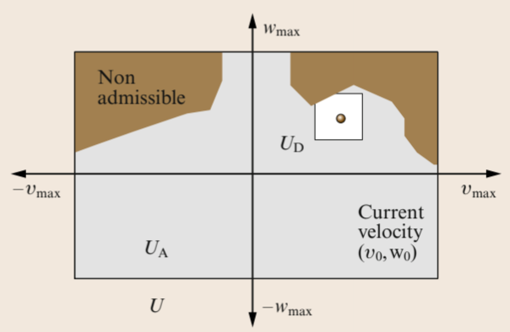

Dynamic Window Approach
STEP 1: FINDING admissible control inputs
Maximum values of linear and angular velocity
$$𝒰=\{(v,ω)∈ℝ^{2}|v∈\left[−v_{max},v_{max}\right],$$
$$ω∈\left[−ω_{max},ω_{max}\right]\}$$

Slide 6
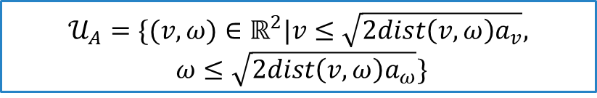
Dynamic Window Approach
STEP 1: FINDING admissible control inputs
Safe velocities to avoid collisions
$$𝒰_{A}=\{(v,ω)∈ℝ^{2}|v≤\sqrt{2dist\left(v,ω\right)a_{v}}, ω≤\sqrt{2dist\left(v,ω\right)a_{ω}}\}$$

Slide 7
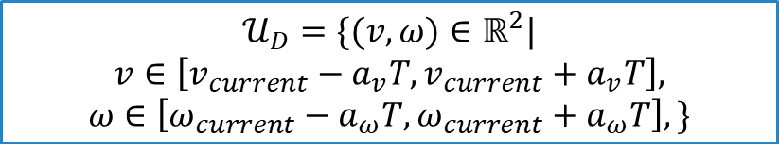
Dynamic Window Approach
STEP 1: FINDING admissible control inputs
Velocities reachable within a control timestep
$$𝒰_{D}=\{(v,ω)∈ℝ^{2}|$$
$$v∈\left[v_{current}−a_{v}T,v_{current}+a_{v}T\right],$$
$$ω∈\left[ω_{current}−a_{ω}T,ω_{current}+a_{ω}T\right],\}$$

Slide 8
Dynamic Window Approach
STEP 1: FINDING admissible control inputs
Intersection of the sets
$$𝒰_{R}=𝒰∩𝒰_{A}∩𝒰_{D}$$

Slide 9
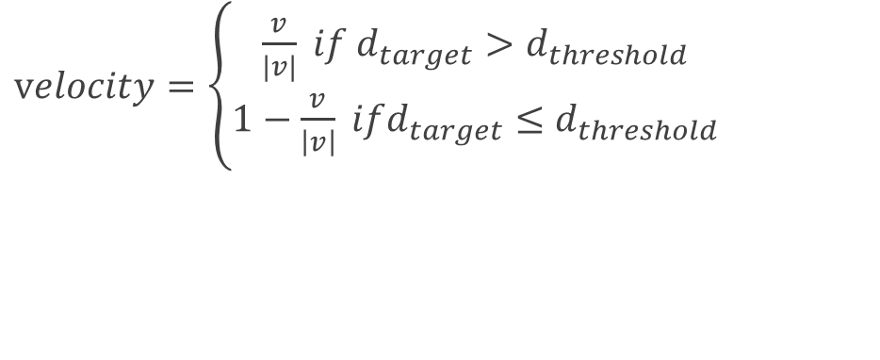


Dynamic Window Approach
STEP 2: SELECTING THE OPTIMAL CONTROL INPUT
$objective = k_{1}⋅heading + k_{2}⋅velocity+ k_{3}⋅clearance$
$$heading=1−\frac{\left|θ^{′}\right|}{π}$$
$velocity=\left\{\begin{aligned}\frac{v}{|v|} if d_{target}>d_{threshold} \\ 1−\frac{v}{\left|v\right|} ifd_{target}≤d_{threshold}\end{aligned}\right.$
$$clearance=\frac{dist\left(v,w\right)}{d_{max}}$$

Slide 10
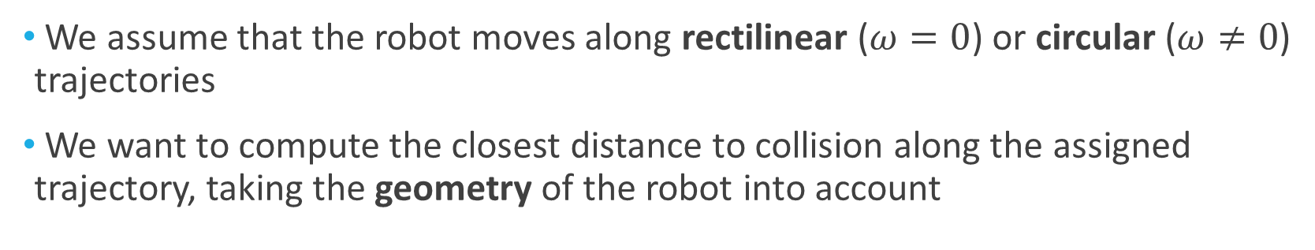
Computing the distance to collision
We assume that the robot moves along rectilinear ($ω=0$) or circular ($ω≠0$) trajectories
We want to compute the closest distance to collision along the assigned trajectory, taking the geometry of the robot into account

Slide 11
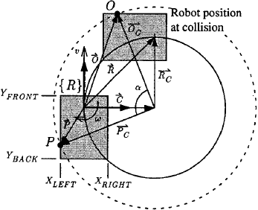
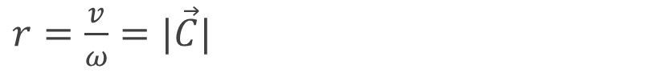
Computing the distance to collision
$r=\frac{v}{ω}=|\vec{C}|$
$r_{o}^{2}={\left(x_{obs}−r\right)}^{2}+y_{obs}^{2}$

Slide 12
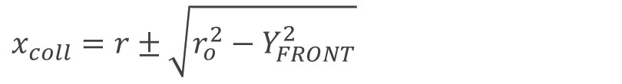
Computing the distance to collision
solve for each side:
$x_{coll}=r±\sqrt{r_{o}^{2}−Y_{FRONT}^{2}}$
$y_{coll}=Y_{FRONT}$

Slide 13
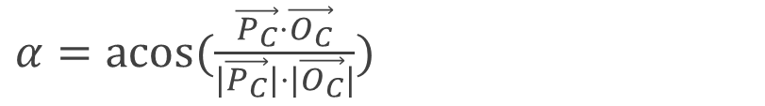
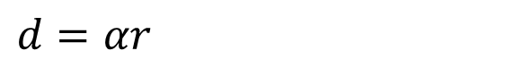
Computing the distance to collision
$α=acos⁡(\frac{\vec{P_{C}}⋅\vec{O_{C}}}{|\vec{P_{C}}|⋅|\vec{O_{C}}|})$
$$d=αr$$

Slide 14
Computing the distance to collision
$$d_{coll}=min⁡\{d_{front},d_{back},d_{left},d_{right}\}$$

Slide 15
Simulations

Slide 16
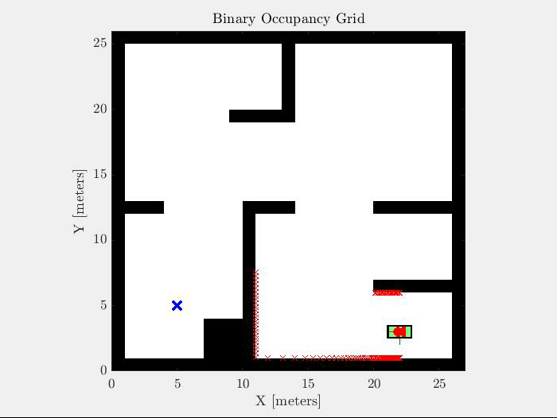
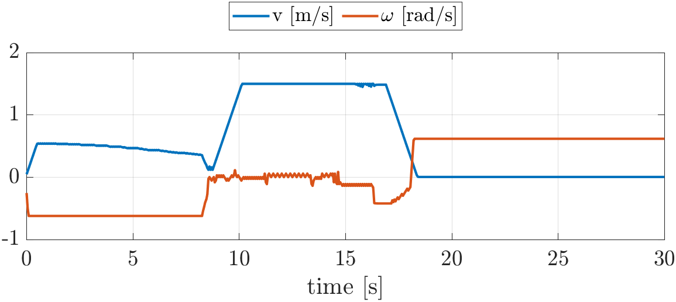
Map 1
FIRST TARGET

Slide 17
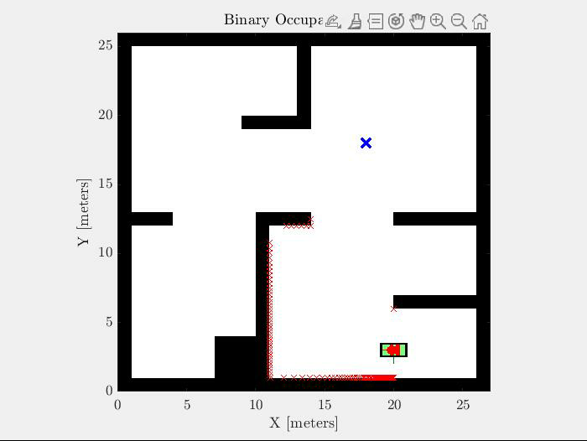
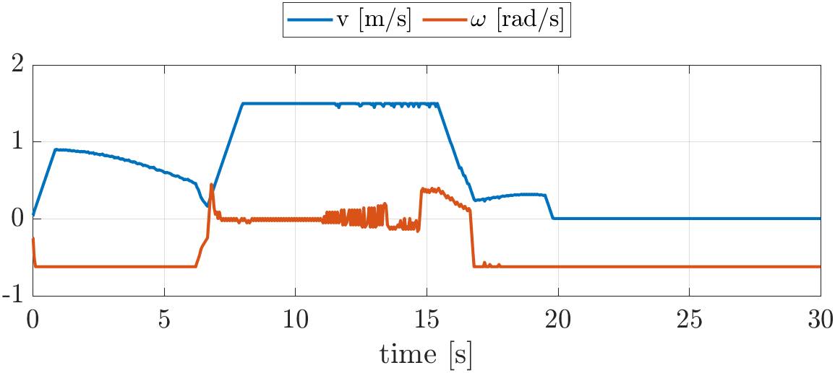
Map 1
SECOND TARGET

Slide 18

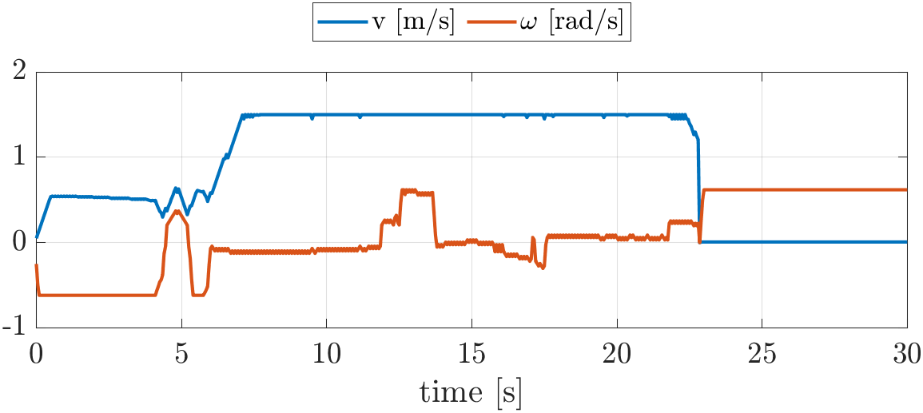
Map 1
THIRD TARGET

Slide 19

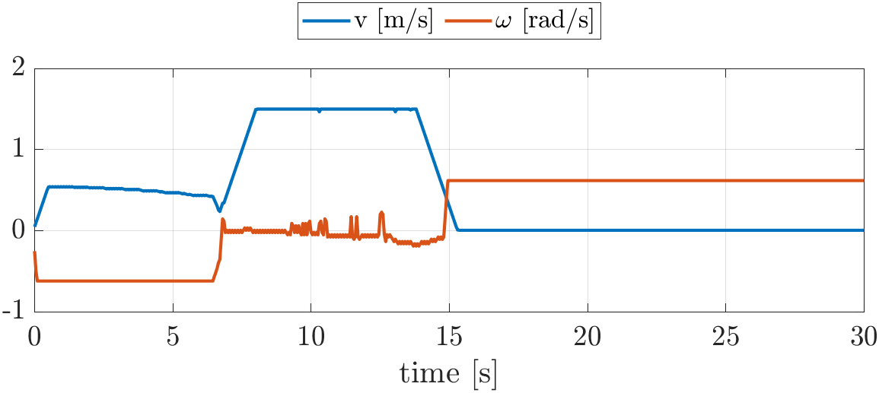
Map 1
FOURTH TARGET

Slide 20
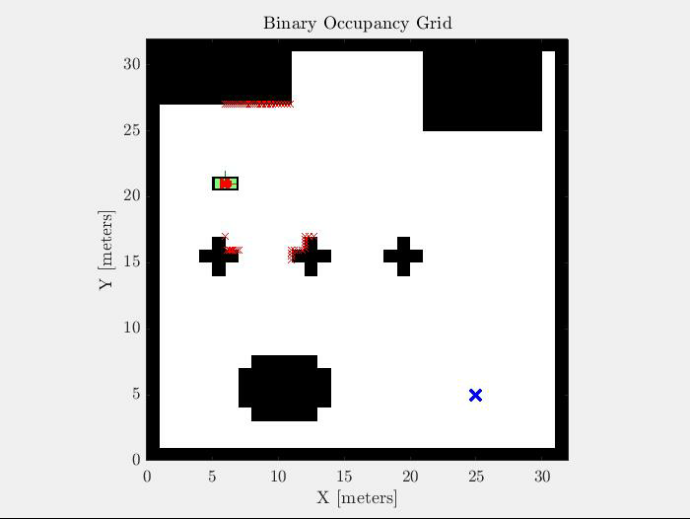
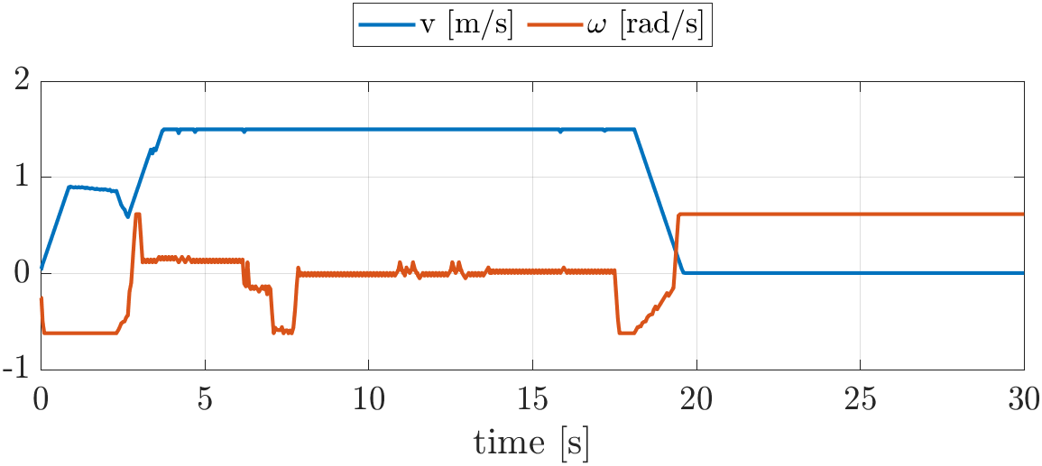
Map 2
FIRST TARGET

Slide 21
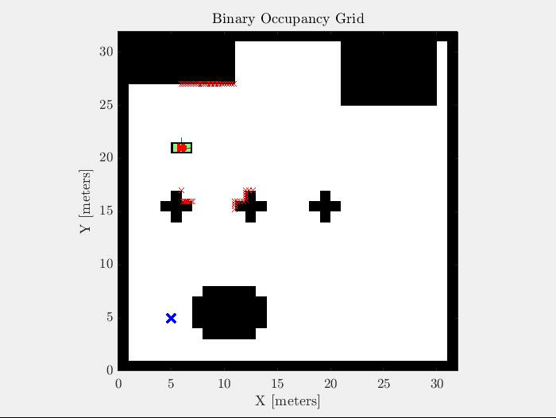
Map 2
SECOND TARGET

Slide 22
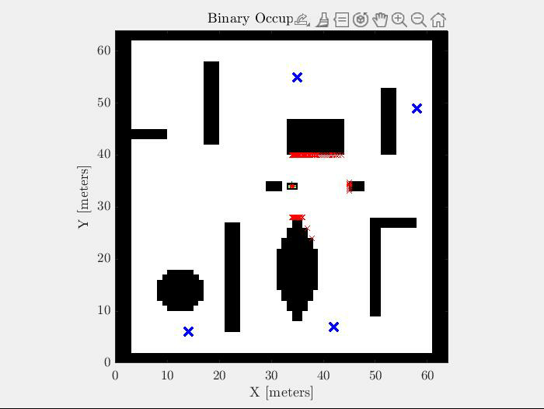
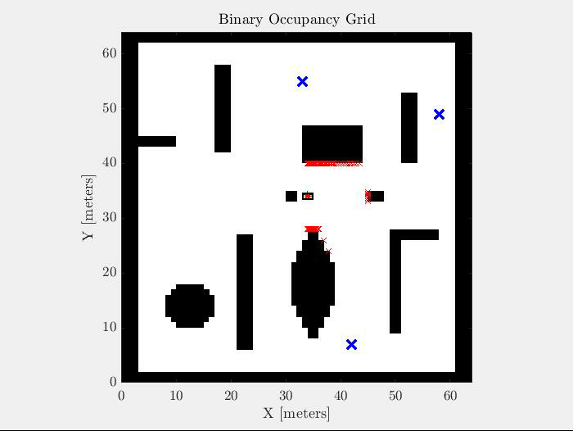
Map 3
SLOW VEHICLE
FAST VEHICLE

Slide 23
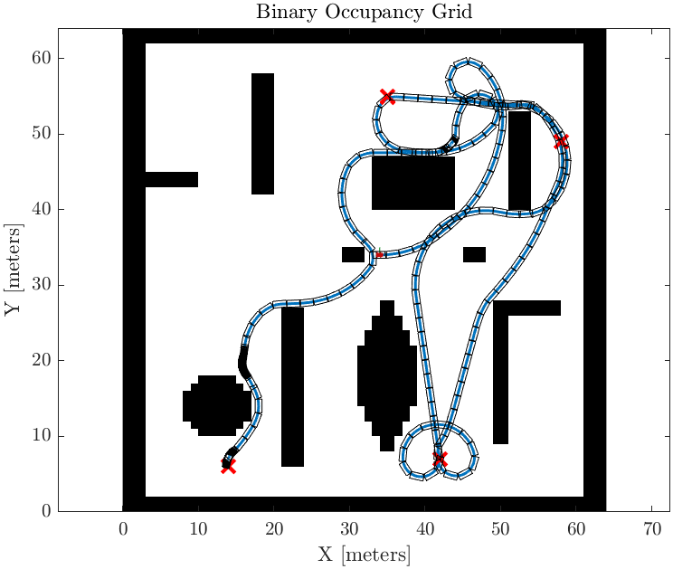
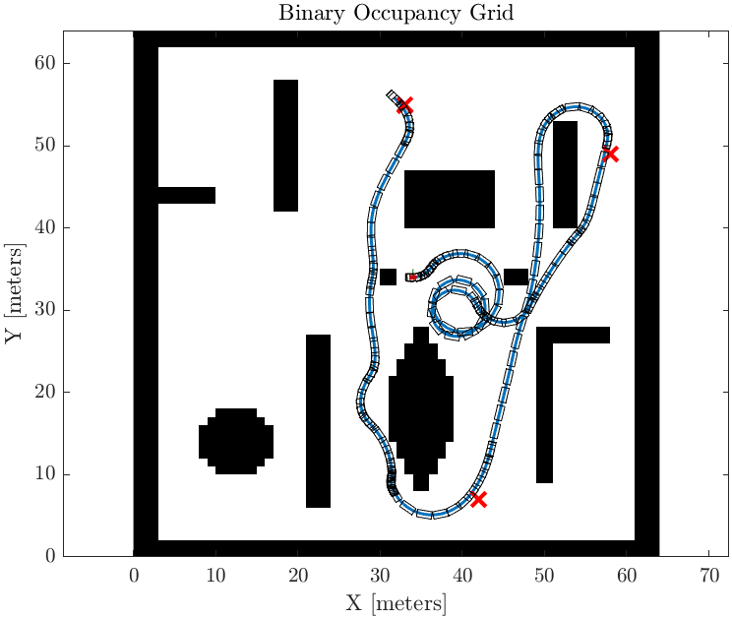
Map 3
SLOW VEHICLE
FAST VEHICLE

Slide 24
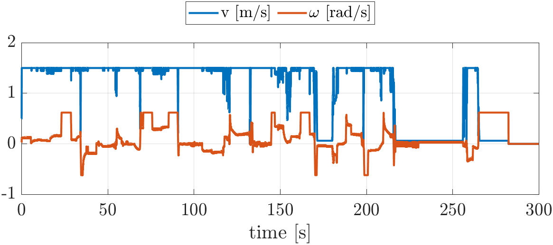
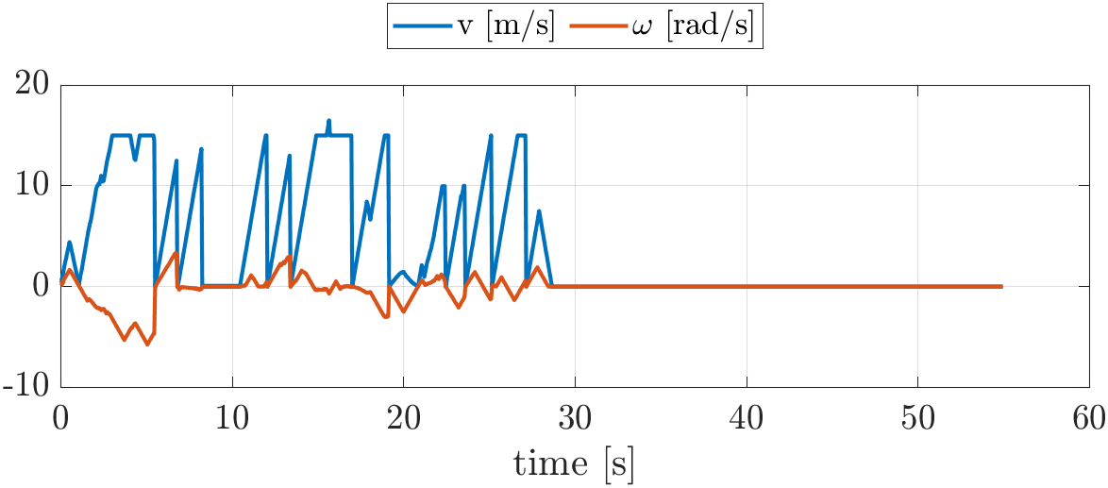
Map 3
SLOW VEHICLE
FAST VEHICLE

Slide 25
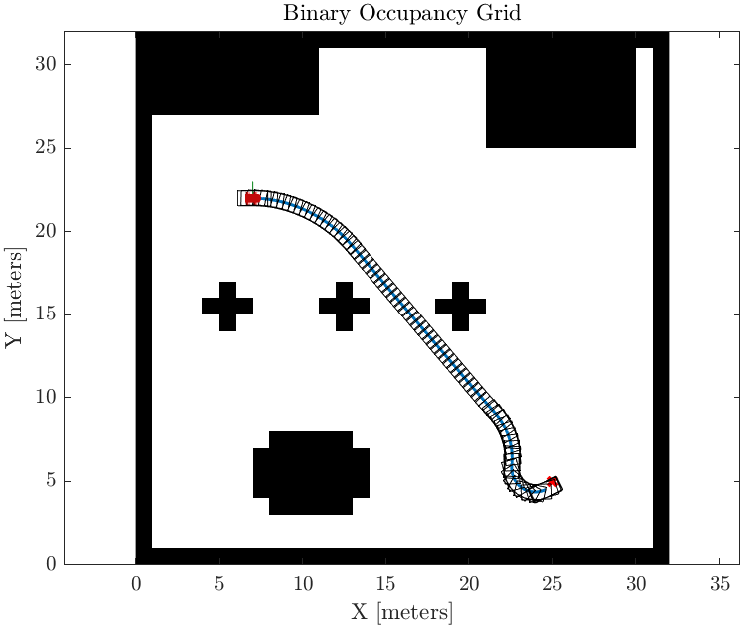
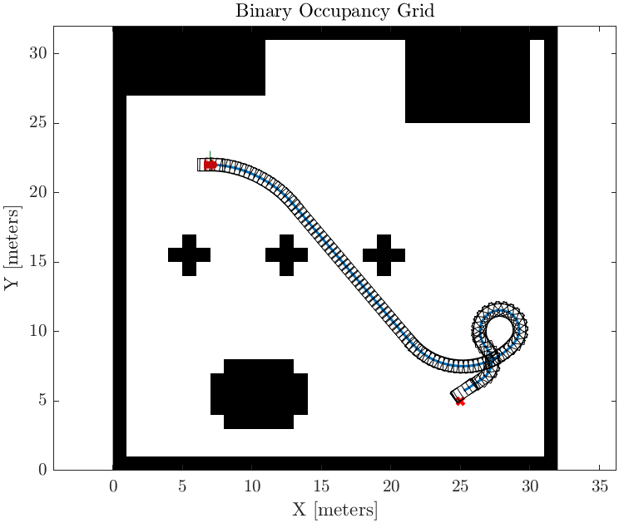
Effects of Different Tunings
HIGHER VELOCITY GAIN
LOWER VELOCITY GAIN

Slide 26
But things can go wrong…
The dynamic window approach suffers from local minima

Slide 27
Conclusions
The robot's kinematic, dynamic, and geometric constraints are integrated in the planning
Simple and effective method
Requires delicate fine-tuning
Suffers from local minima
Trade-off between accuracy and versatility

Slide 28
Thank you for your attention!

